Slide 1
Queries

Slide 2
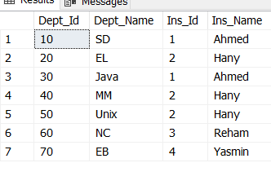
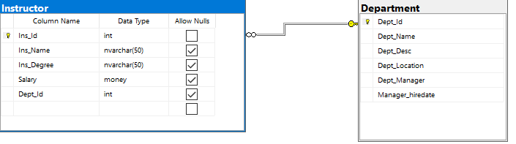
-- Display the Department id, name and id and the name of its manager.
select D.Dept_Id, D.Dept_Name, I.Ins_Id, I.Ins_Name
from department D inner join Instructor I
on D.Dept_Manager = I.Ins_Id

Slide 3
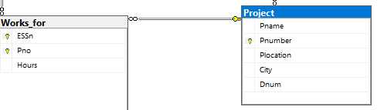
For each project, list the project name, project number and the total hours per week (for all employees) spent on that project.
select P.Pname, P.Pnumber, SUM(WF.Hours) as "total hour"
from Project P inner join Works_for WF
on P.Pnumber = WF.Pno
group by P.Pnumber, P.Pname

Slide 4
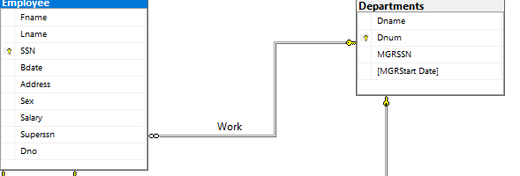
Display the data of the department which has the smallest employee ID over all employees' ID.
select D.* from Departments D inner join Employee E
on D.Dnum = E.Dno
where E.SSN = (select MIN(Employee.SSN)from Employee where Employee.Dno is not null)

Slide 5
For each department, retrieve the department name and the maximum, minimum and average salary of its employees.
select D.Dname, MAX(E.Salary) as max_salary, MIN(E.Salary)[min salary], MAX(E.Salary) "avg salary"
from Departments D join Employee E
on D.Dnum = E.Dno
group by D.Dnum, D.Dname

Slide 6
-- List the full name of all managers who have no dependents.
select CONCAT(ISNULL(E.Fname, 'no first name'),' ', E.Lname) [full name]
from Employee E join Departments D
on E.SSN = D.MGRSSN
where E.SSN not in (select distinct Dependent.ESSN from Dependent)

Slide 7
For each department if its average salary is less than the average salary of all employees display its number, name and number of its employees.
select D.Dnum, D.Dname, count(E.SSN) from Departments D join Employee E
on D.Dnum = E.Dno
group by D.Dnum, D.Dname
having AVG(E.Salary) < (select AVG(Salary) from Employee)

Slide 8
Display number and name of employee if at least one of them have dependents by two ways
-- (use exists keyword)
select distinct E.SSN, E.Fname from Employee E inner join Dependent D on E.SSN = D.ESSN
select E.SSN, E.Fname from Employee E where E.SSN in (select distinct Dependent.ESSN from Dependent)
SELECT E.SSN, E.FName+' '+E.LName as "full name"
FROM Employee E WHERE EXISTS (SELECT D.ESSN FROM Dependent D WHERE D.ESSN = E.SSN);

